Slide 1
Module - 2

Slide 2
User-Centered Design (UCD)

Slide 3
Cont…
Interaction Design Process is the "how" — the process to create good user interfaces.
User-Centered Design is the "mindset" — the idea that everything should be built around the user's needs.

Slide 4
Cont…
User-Centered Design is a design philosophy and a process in which users' needs, goals, and feedback are the central focus at every stage of the design and development cycle.
The goal is to create interactive systems that are usable, useful, and meaningful to users by deeply understanding their needs, behaviors, contexts, and limitations.
User-Centered Design (UCD) is a design philosophy and process that keeps the user at the heart of every step in designing a product, system, or interface.❝ UCD is about designing for the users, with the users, and around their needs. ❞

Slide 5
Cont…
Principles of UCD
Principle | Explanation
👥 Focus on users | Understand who your users are, what they need, and what tasks they perform.
🔁 Iterative design | Refine designs continuously based on feedback.
🧪 Early prototyping and testing | Test designs early using wireframes, mockups, or paper prototypes.
📊 Empirical measurement | Use usability testing, interviews, and observations to gather real data.
💬 User involvement | Users are engaged throughout — not just at the beginning or end.

Slide 6
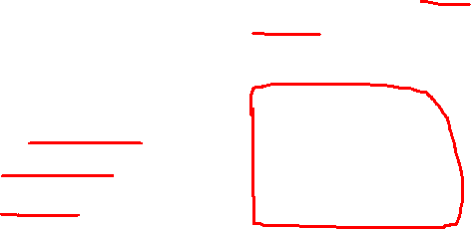
Cont…
Steps in a UCD Process
Step No. | UCD Step | Description | Key Activities | Example
1 | Understand the Context of Use | Identify who the users are, their goals, environment, and how they’ll use the product. | User research, interviews, observations, persona creation | Interview teachers and students to learn how they use the current university portal.
2 | Specify User Requirements | Define what users need from the system based on research. | User stories, use cases, task analysis | “Users want instant access to attendance and exam results.”
3 | Design Solutions | Generate multiple design ideas and concepts. | Sketching, wireframing, storyboarding | Create two layouts for the dashboard: one grid-based, one list-based.

Slide 7
Cont…
Step No. | UCD Step | Description | Key Activities | Example
4 | Prototype the Design | Create basic interactive models of the product. | Paper prototypes, digital mockups (Figma, Adobe XD) | Make a clickable prototype for students to navigate their timetable.
5 | Evaluate with Users | Test the prototype with real users and get feedback. | Usability testing, A/B testing, heuristic evaluation | Students find the font too small and suggest bigger buttons.
6 | Iterate | Improve the design based on feedback and repeat steps if needed. | Redesign, refine prototypes, re-test | After changes, test again to see if the new layout solves the earlier issues.

Slide 8
Real-Life Example: Designing a Library App for Students
Step | Action
Understand | Talk to students, learn they forget due dates.
Requirements | “Send due date reminders” is a requirement.
Design | Sketch a screen with a calendar and alert system.
Prototype | Build an app demo with alert feature.
Evaluate | Students test it. They want clearer notifications.
Iterate | Improve based on their feedback and test again.

Slide 9

Activities of UCD
Order | UCD Activity | Description
1️⃣ | Personas | Fictional user profiles based on research that represent different user types and guide design decisions.
2️⃣ | Storyboarding | Visual narratives that show how users interact with the system step-by-step, capturing context, tasks, and emotions.
3️⃣ | Wireframing | Low-fidelity layout blueprints that define the structure and placement of UI elements on screens.
4️⃣ | Prototyping | Interactive or visual models of the system (low to high fidelity) used to explore functionality and get user feedback.
5️⃣ | Usability Testing | Observing users as they interact with prototypes to evaluate effectiveness, efficiency, and satisfaction.

Slide 10
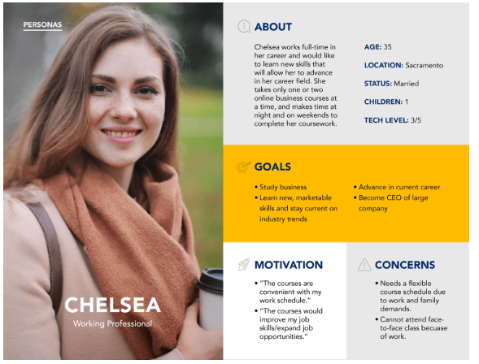
PERSONAS

Slide 11
A persona is a fictional but realistic representation of a target user. It’s based on user research and describes key attributes of a user group such as goals, behavior patterns, needs, frustrations, and motivations.

Slide 12
Cont…
Purpose of Using Personas
Purpose | Explanation
👥 Understand users | Make design decisions grounded in user reality
🎯 Focus design | Keep the team focused on user goals
🤝 Align team vision | Avoid assumptions; unify design perspective
✍️ Guide content & features | Helps in deciding tone, interaction flow, layout

Slide 13
Key Components of a Persona
Component | Description | Example
Name | Fictional, realistic name | Priya Sharma
Photo | Helps humanize the persona | (Attach a stock image)
Age / Gender | Basic demographics | 32, Female
Job / Background | Context of use | School Teacher in Chennai
Goals | What the user wants to achieve | Wants to manage online classes easily
Pain Points | Frustrations faced | Poor UI in current tools, long login times
Behaviors | How they use tech | Prefers mobile over desktop
Tech Comfort | Tech-savvy or not | Intermediate – uses Zoom, WhatsApp

Slide 14
Cont…
Example Persona for an Educational App
Field | Details
Name | Ravi Kumar
Age | 45
Occupation | School Principal
Goals | Wants an app to track teachers' performance & attendance easily
Frustrations | Doesn’t like complicated dashboards or too many settings
Tech Use | Uses WhatsApp, rarely uses laptop
Needs | Simple UI, mobile-first interface, reports in PDF

Slide 15
Cont…
Types of Personas
Type | Description | Example
Primary Persona | Main focus of design | Frequent app users
Secondary Persona | Supported but not prioritized | Admins who rarely log in
Negative Persona | Who you're not designing for | Hackers, non-paying users
Proto-Persona | Quick, assumption-based version | Used early in design without full research

Slide 16
Cont…
How to Create Personas (Step-by-Step)
Conduct User Research Surveys, interviews, observations
Identify Patterns Group behaviors, motivations, goals
Build Persona Profile Fill in details (name, age, tech use, etc.)
Share & Use In team meetings, design reviews, testing sessions

Slide 17
STORYBOARDING

Slide 18
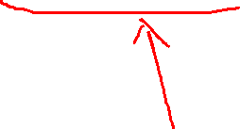
Storyboarding is a visual storytelling technique used to represent how a user will interact with a system step-by-step.
It’s like a comic strip showing the user's journey through the product — from start to end.

Slide 19
Cont…
Purpose of Storyboarding in HCI
To visualize the user experience
To communicate ideas to team members and stakeholders
To identify user pain points and interface improvements
To support design thinking and user-centered design

Slide 20
Cont…
What Storyboards Include
The user’s goal
The context/environment
Screens or interfaces
The sequence of actions
Emotions or reactions

Slide 21
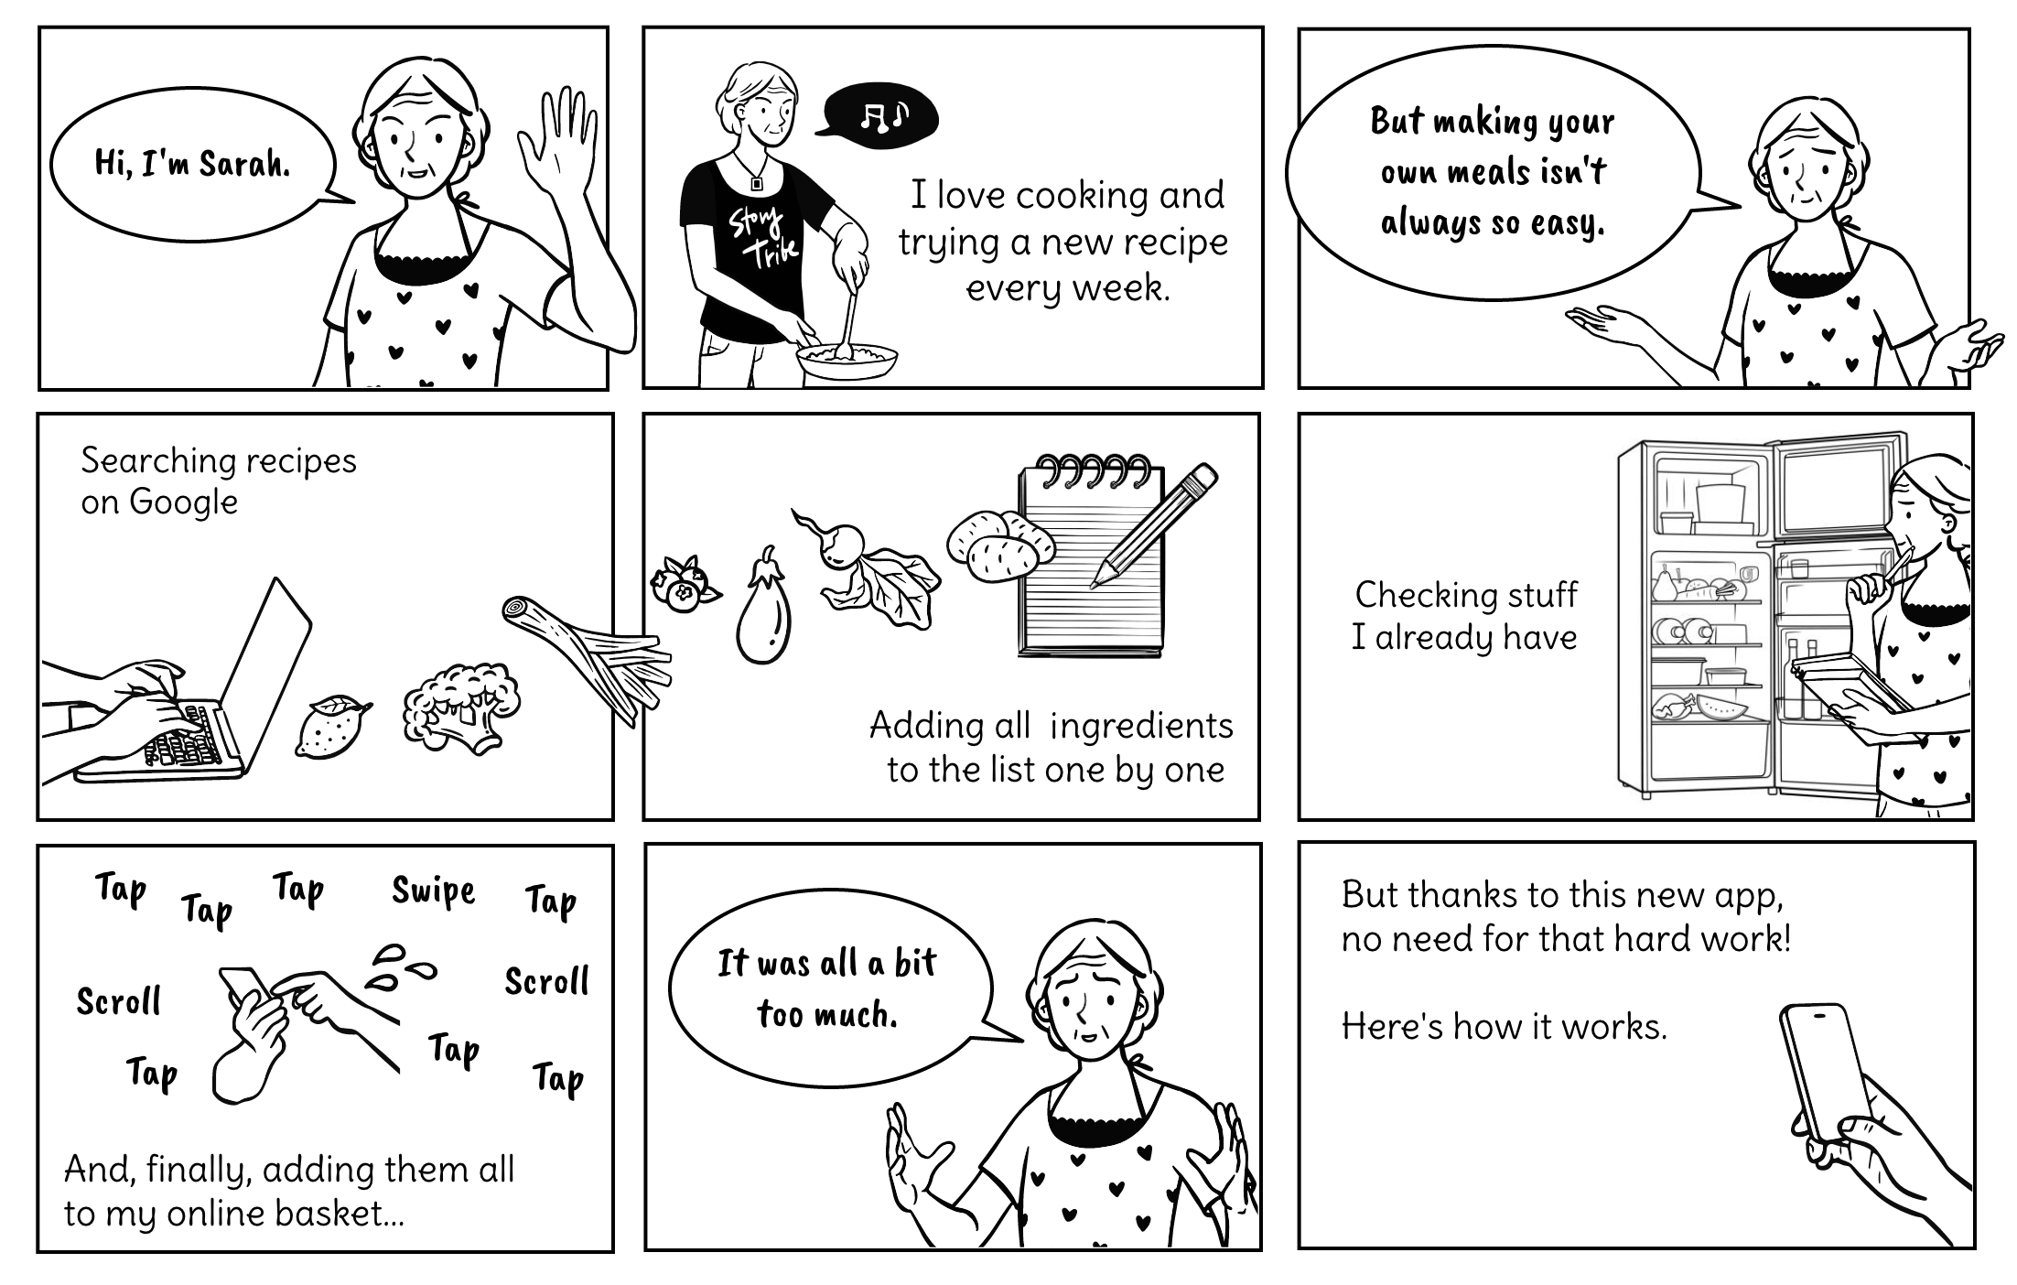

Slide 22

Cont…
Key Elements of a Storyboard
Element | Description | Example
Scene | A step or moment in the user journey | User opens the mobile app
User | Who is performing the action | College student named Ravi
Task/Action | What the user is doing | Ravi searches for a book in the library app
Interface | The system response or screen | Search results show book titles
Emotion | How the user feels | Ravi is happy the app is fast and accurate

Slide 23
Cont…
Types of Storyboards
Type | Purpose | Example
Low-Fidelity | Rough sketches to explore ideas | Hand-drawn user steps
High-Fidelity | Polished, detailed visuals | Screens made in Figma or PowerPoint

Slide 24
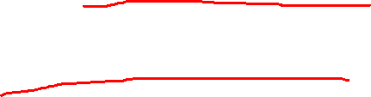
Cont…
Where It Fits in UCD Process
Storyboarding is usually done in:
Step 2: Specify Requirements → Visualize user needs
Step 3: Design Solutions → Explore UI flows and ideas

Slide 25
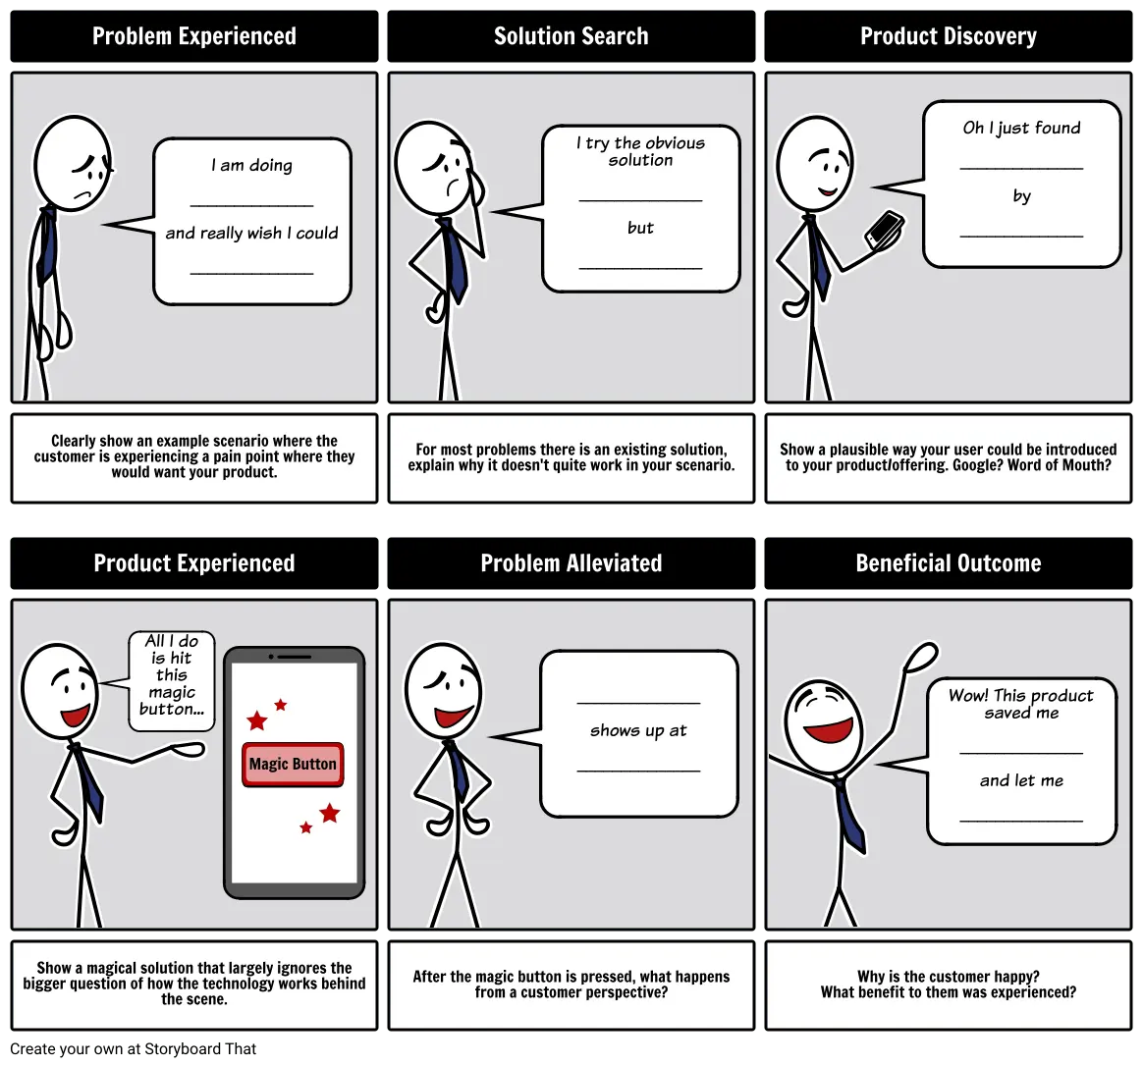
Cont…

Slide 26
WIREFRAMING

Slide 27
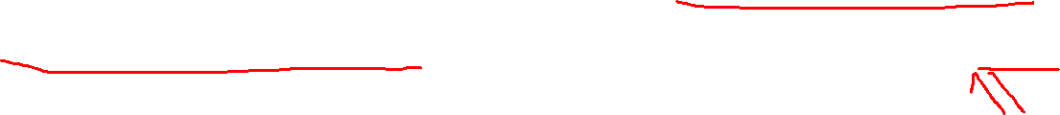
Cont…
A wireframe is a basic visual guide that represents the structure, layout, and functionality of a user interface (UI), without focusing on design aesthetics like color, font, or images.
Think of it as a blueprint for a website, app, or interface.
It’s usually low-fidelity: black and white sketches or outlines.
It helps teams visualize user flow, placement of elements, and test early interactions.

Slide 28
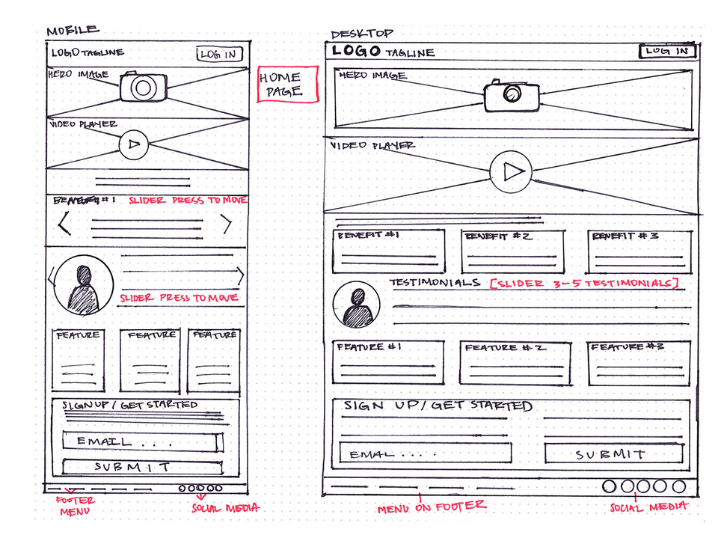
Example:

Slide 29
Goals of Wireframing in HCI
Visualize Layout – Arrange content and interface elements logically.
Focus on Functionality – Plan how users will interact with the system.
Identify Usability Issues Early – Avoid costly redesign later.
Communicate Design Clearly – Between UX designers, developers, stakeholders, and users.
Support Iterative Design – Modify easily based on feedback.

Slide 30
Where Wireframing Fits in UCD/HCI Process
Step 3: Design Solutions Wireframing happens after gathering user requirements, but before creating prototypes.

Slide 31
Cont…
Types of Wireframes
Type | Description | Tools
✏️ Low-Fidelity | Simple sketches or black-and-white digital mockups | Pen & Paper
🧩 Mid-Fidelity | Includes actual UI structure and placeholders | Figma, Adobe XD
🎨 High-Fidelity | Near-final design with UI components, fonts, and images | Figma, Sketch, Adobe XD

Slide 32
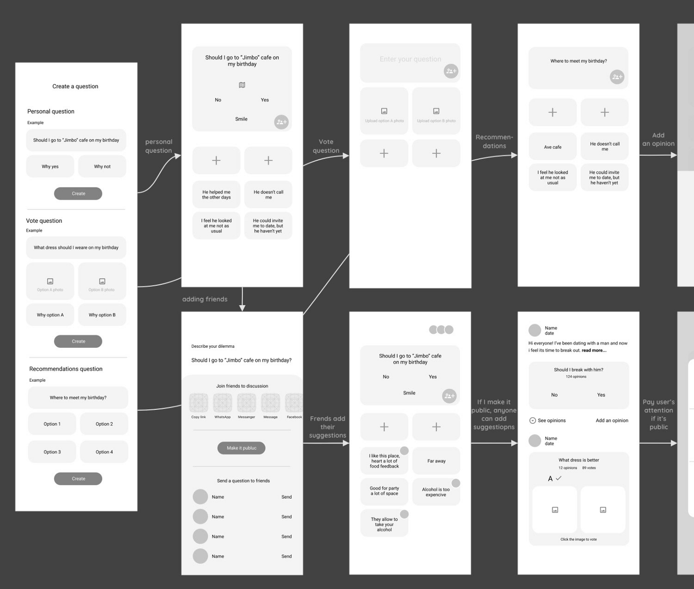

Slide 33
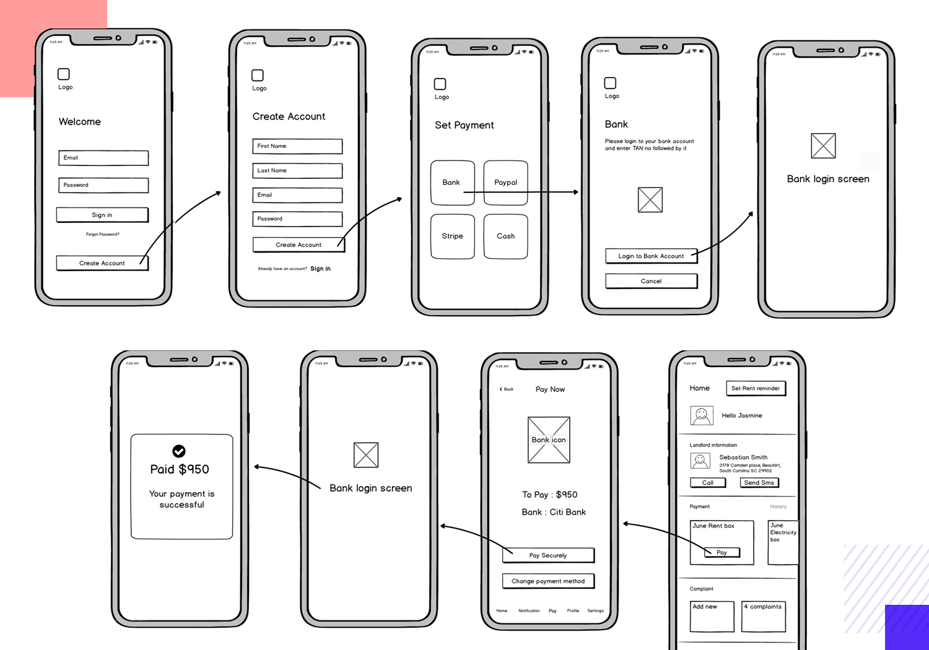

Slide 34
Why Use Wireframes in HCI?
Benefit | Explanation
✅ Early Feedback | Quickly show stakeholders/users how the app will look and work.
✅ Focus on Usability | Helps ensure key functions are easy to find and use.
✅ Easy Iteration | Cheaper to change wireframes than built designs.
✅ Clear Communication | Everyone (designers, developers, clients) stays on the same page.
✅ Saves Time & Cost | Prevents rework later in development.

Slide 35
Prototyping in HCI
Wireframe is like a building blueprint — it shows the layout of rooms.
Prototype is like a walkthrough model house — you can open doors, walk around, and see how things feel.

Slide 36
Cont…
A prototype is a sample or model of a system or interface, created before the actual product is built, to test ideas and get feedback.
Think of it as a "rough draft" of a website, app, or product screen that helps designers and users understand how it will work.
Prototyping is the bridge between ideas and real products. It lets you build, test, and refine the design before development, making systems more user-friendly and less costly to fix later.

Slide 37
Cont…
Why is Prototyping Important in HCI?
Reason | Explanation
🧠 Clarifies ideas | Helps designers turn ideas into something visual or interactive.
👥 User feedback | Real users can test and give feedback early.
🔁 Quick improvements | Easy to fix mistakes or change layouts before coding.
💸 Saves time & cost | Catch problems early and avoid expensive rework later.

Slide 38
Cont…
Types of Prototypes
Type | What It Looks Like | Purpose | Tools
✏️ Low-Fidelity | Sketches, simple wireframes (no color or details) | Explore ideas quickly | Paper, Balsamiq
🧩 Mid-Fidelity | Clickable screens, grey layouts (some interaction) | Test navigation flow | Figma, Adobe XD
🎨 High-Fidelity | Realistic design, close to final product | Usability testing | Figma, Sketch
💻 Functional | Working code version (real app or site) | Final testing | HTML, JavaScript

Slide 39
Cont…
Example — Prototyping a Login Screen
Stage | Description | Example
Low-Fidelity | Rough sketch of login form | Username, password boxes and "Login" button
Mid-Fidelity | Clickable layout | Pressing login moves to next screen
High-Fidelity | Styled design with real fonts/colors | Shows loading animation, error messages
Functional | Coded page | Actually logs in a user

Slide 40
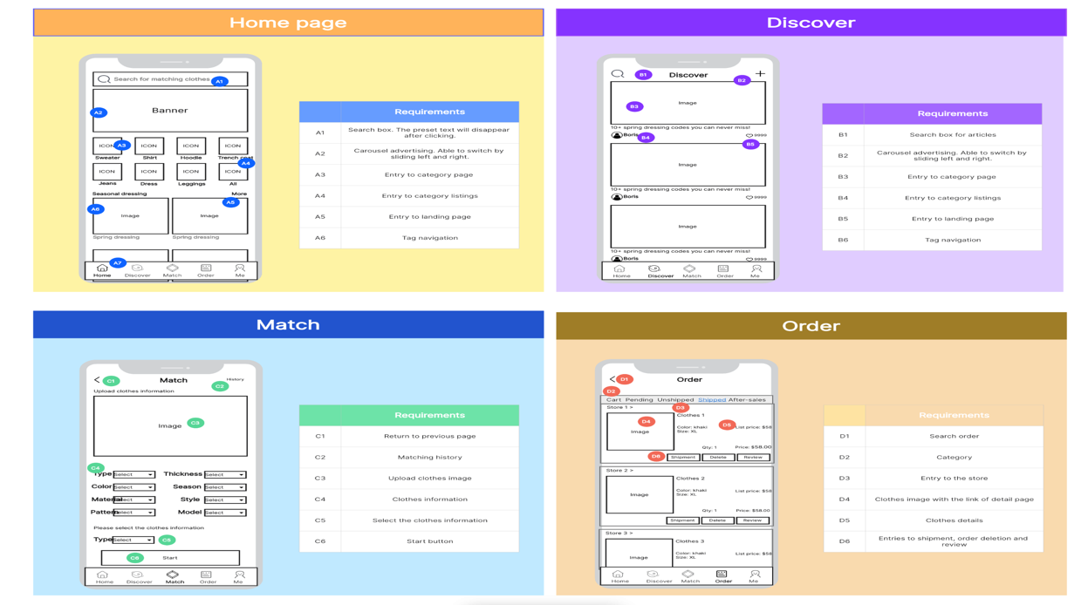

Slide 41
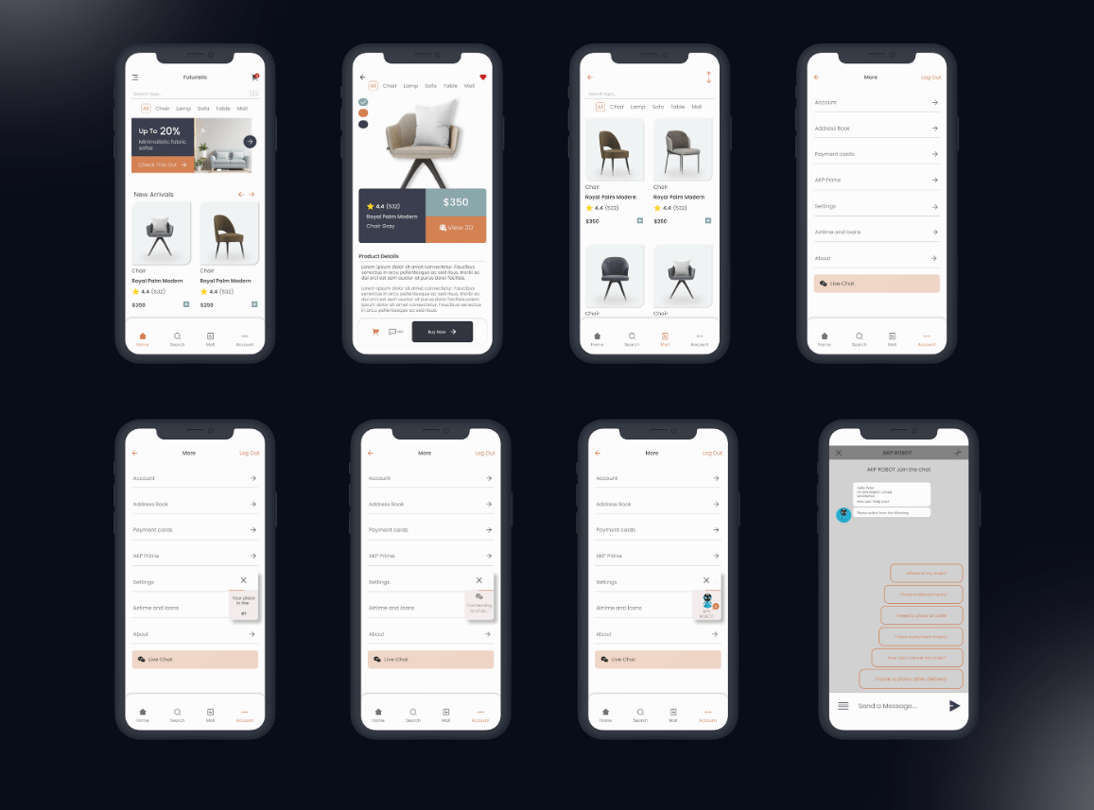

Slide 42
Wireframing vs. Prototyping
Aspect | Wireframe | Prototype
Definition | A static blueprint or layout of a screen | A working model that simulates how a user will interact with the product
Purpose | Focuses on structure and content placement | Focuses on user flow and interaction behavior
Fidelity | Usually low or medium fidelity | Can be medium to high fidelity
Interactivity | Usually non-interactive (static layout) | Interactive — allows clicks, transitions, animations
Tools | Balsamiq, Wireframe.cc, Sketch, Figma (static use) | Figma (interactive mode), Adobe XD, InVision, Proto.io
Used in | Early design stages — to align structure, hierarchy, and content | Mid to late stages — to test usability, simulate user journey
Looks Like | Grey boxes, placeholders, minimal detail | Real content, clickable elements, transitions
Output Type | Diagrams or mockups | Simulated user experience

Slide 43
Example Comparison
Feature | Wireframe | Prototype
Login screen with input fields | Shows layout of email & password fields | Allows user to enter inputs, click "Login", and go to next page
Menu | Static text or icons | Interactive drop-down that opens/closes on click
Buttons | Placeholder rectangles | Clickable, triggers transitions or new views

Slide 44
When to Use Which?
🧱 Wireframes → For planning the structure, content, and layout early in the design.
🚀 Prototypes → For testing interactions, flows, and getting user feedback before development.

Slide 45

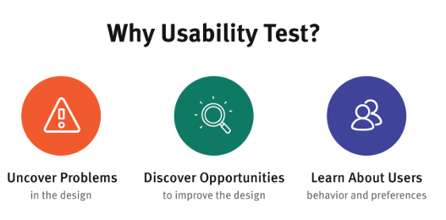
USABILITY TESTING

Slide 46
Cont…
Usability Testing is a technique used to evaluate a product or interface by observing real users as they try to complete tasks.
The goal is to uncover usability problems, understand user behavior, and improve the product’s effectiveness, efficiency, and satisfaction.

Slide 47
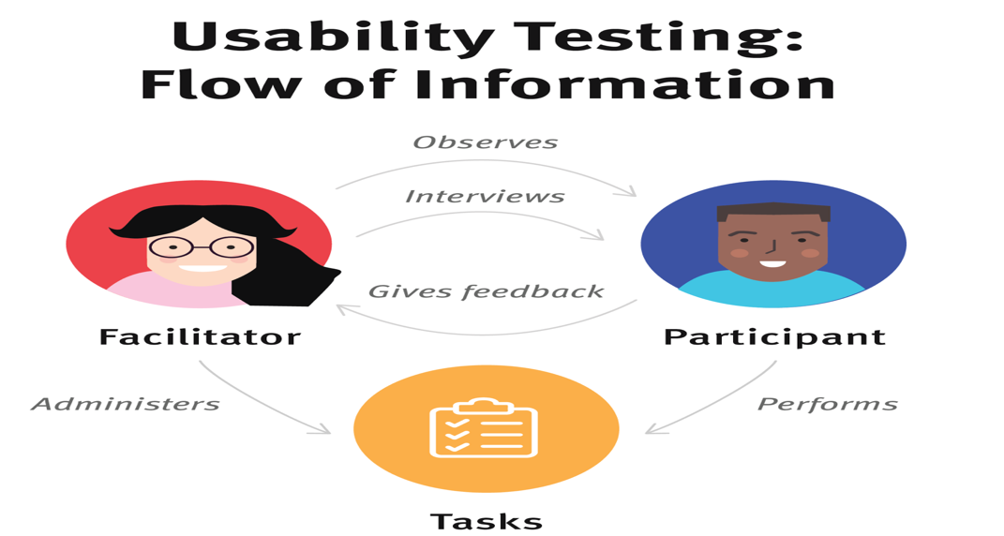

Slide 48
Cont…
Purpose of Usability Testing
Goal | Explanation
✅ Identify pain points | Understand where users get stuck or confused
✅ Improve efficiency | Reduce steps or complexity in key tasks
✅ Validate design choices | Confirm whether the layout, labels, and flow make sense
✅ Enhance satisfaction | Ensure users enjoy the experience and complete goals easily

Slide 49
Cont…
Where Usability Testing Fits in the UCD Process
UCD Step | Activity
Step 4: Evaluate Design Solutions | This is where Usability Testing occurs
Step 5: Iterate | Use the results of usability testing to improve the design

Slide 50
Cont…
Types of Usability Testing
Type | Description | Example
Moderated Testing | A facilitator guides the user during the test | In a lab or via Zoom
Unmoderated Testing | Users complete tasks on their own | Using tools like Maze or UserTesting
Remote Testing | Done online without meeting the user in person | Screen is recorded for analysis
In-Person Testing | Done face-to-face | Often in a usability lab
A/B Testing | Compare two versions to see which performs better | Two versions of a homepage

Slide 51
Cont…
Components of a Usability Test
Component | Description
Participants | Real users who match the target audience
Tasks | Realistic actions they would perform (e.g., “Log in and book a train ticket”)
Scenarios | Contexts that explain why they’re doing the task
Observers | Designers or evaluators watching and taking notes
Metrics | Time taken, errors made, success rate, satisfaction score

Slide 52
Cont…
Example: Usability Testing for a Library App
Task | Observation | Issue Identified
Search for a book | User types but finds no result | Search bar doesn’t handle spelling mistakes
Reserve a book | User can’t find the “Reserve” button | Poor button placement and label

Slide 53
Cont…
Common Usability Metrics
Metric | What It Measures
Task Success Rate | % of users who completed the task successfully
Time on Task | How long users take to complete a task
Error Rate | Mistakes made during the task
System Usability Scale (SUS) | User-rated score of overall usability
Satisfaction Score | How happy users were with the experience (e.g., Likert scale)

Slide 54
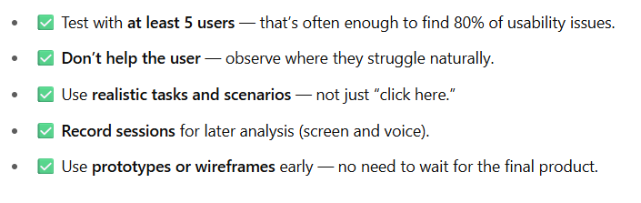
Cont…
Best Practices for Usability Testing

Slide 55
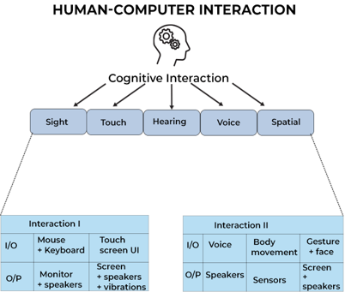
Conceptualizing Interaction — in HCI

Slide 56
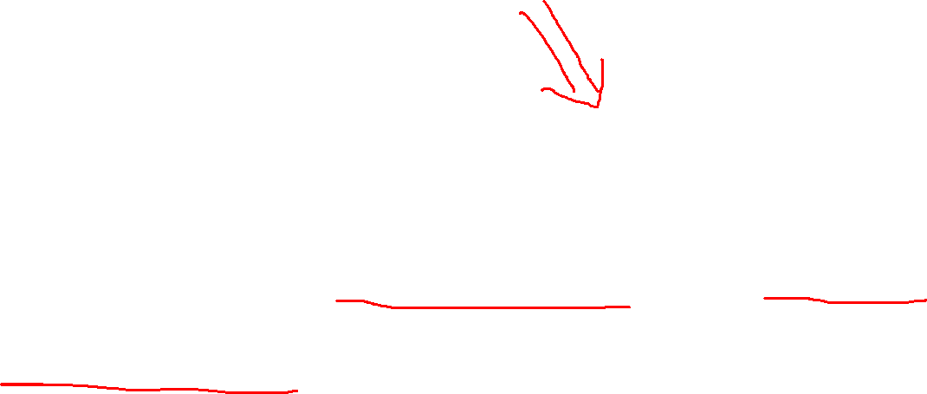
Cont…
It means thinking about and designing how users interact with a system — the actions users take and how the system responds.
It’s about answering: “What will the user do?” and “How will the system respond?”

Slide 57
Cont…
Why Is Conceptualizing Interaction Important?
1. Helps define the core functionality of a system.
2. Focuses on user goals, not just system features.
3. Avoids poor design by aligning interaction flow with mental models of users.

Slide 58
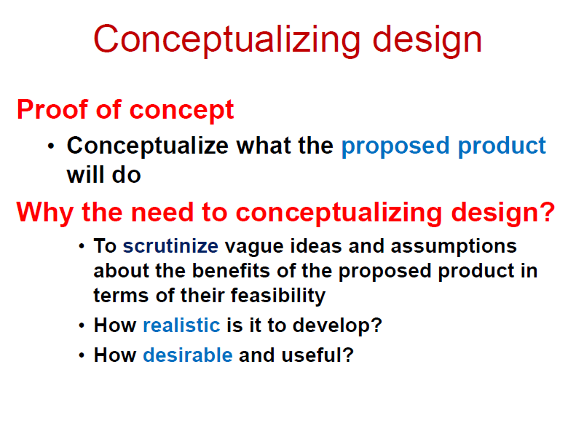

Slide 59
Cont…
1. What Does It Mean?
It is about:
Defining what actions users can take
Understanding how they do it (input methods)
Designing how the system responds
Considering user goals, context, and feedback loops

Slide 60
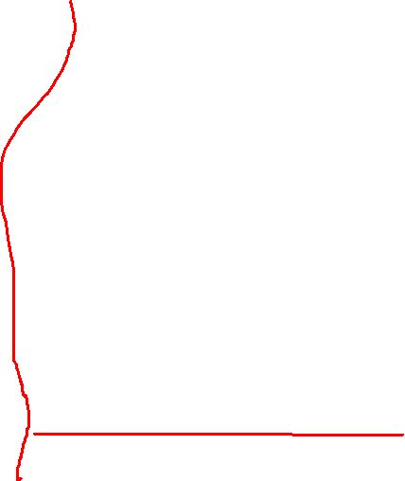
Cont…
2. Components of Interaction
Component Description
User The person interacting with the system
System The software/hardware the user interacts with
Input What the user does (e.g., click, type, speak)
Output How the system responds (e.g., displays data,
voice feedback)
Feedback System acknowledgment (e.g., animation, sound, message)

Slide 61
Cont…
3. Approaches to Conceptualizing Interaction
a. Interaction Frameworks
Norman’s Execution–Evaluation Cycle
Abowd and Beale’s Interaction Framework
b. Interaction Styles
Style Example
Command Line Typing commands (e.g., Linux Terminal)
Menu Selection Choosing from a menu (e.g., File → Save)
Form Fill-in Online forms
Direct Manipulation Drag & drop, sliders (GUI)
Natural Language Voice assistants (e.g., Alexa, Siri)
Gesture & Touch Mobile apps, touchscreen UIs
Augmented/Virtual Reality Immersive interaction

Slide 62
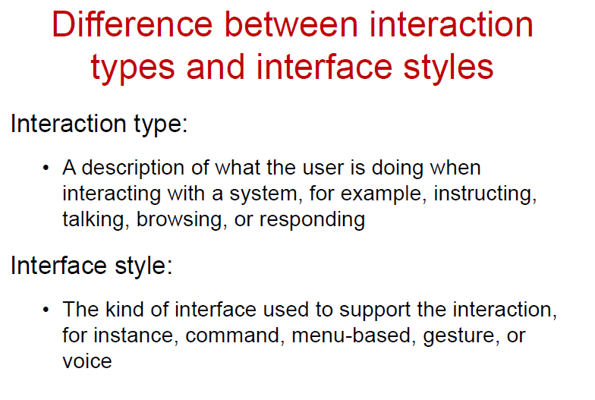
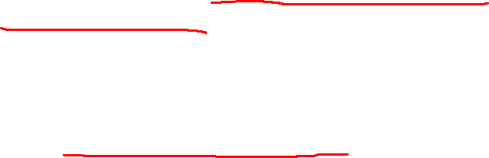

Slide 63
Cont…
4. Goals of Conceptual Interaction Design
Make systems intuitive and usable
Align system behavior with user mental models
Ensure accessibility and inclusivity
Provide clear feedback and control
Minimize errors and frustration

Slide 64
Cont…
5. Real-world Examples
System Interaction Conceptualization
ATM Sequence of physical + digital actions (insert card → enter PIN → choose options)
Mobile App Touch, swipe, voice input, responsive feedback
Smart Speaker Voice input, conversational feedback, confirmation loops
E-commerce Website Browsing → cart → checkout → confirmation feedback

Slide 65
Cont…
Key Questions to Ask:
Question | Purpose
What kind of interaction is being supported? | E.g., browsing, searching, creating, modifying
What will users do with the system? | Input, gestures, typing, voice, etc.
What feedback will the system provide? | Visual, sound, haptic
How will users understand and learn it? | Affordances, metaphors, conventions

Slide 66
Common Types Interaction Styles:
Interaction Type | Description | Example
Command-Line | Text-based commands | Terminal, Linux
Menu Selection | Predefined options | ATM menu
Form-Fill In | Data entry | Registration forms
Direct Manipulation | Drag-and-drop, point & click | File manager, Canva
Natural Language | Using human language | Siri, Alexa
Gesture-Based | Hand or body movement | Touch gestures, AR/VR
Conversational | Chat-based UIs | ChatGPT, WhatsApp bots

Slide 67
Cont… Main Interaction Types in HCI 1. Instructing
User gives commands or instructions to the system to perform actions.
Best For: Quick, precise actions by experienced users
Challenge: Requires user memory and knowledge
Feature | Example
Direct, often text-based | Command line (e.g., Linux shell)
Menu-driven | "File > Save" in MS Word
Button-based | Clicking “Send” in Gmail

Slide 68
Cont…
2. Conversing
User interacts through dialogue — like a conversation with the system.
Best For: Natural, flexible interaction
Challenge: Can misinterpret input; needs good NLP
Feature | Example
Natural language or chatbot-style | Siri, Alexa, ChatGPT
Text-based or voice input | Chatbots in customer support

Slide 69
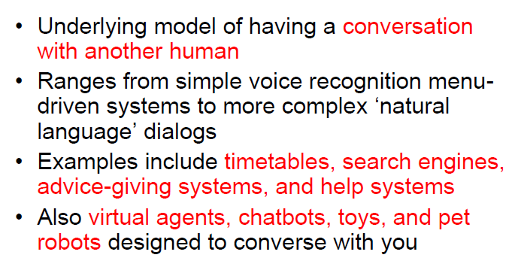

Slide 70
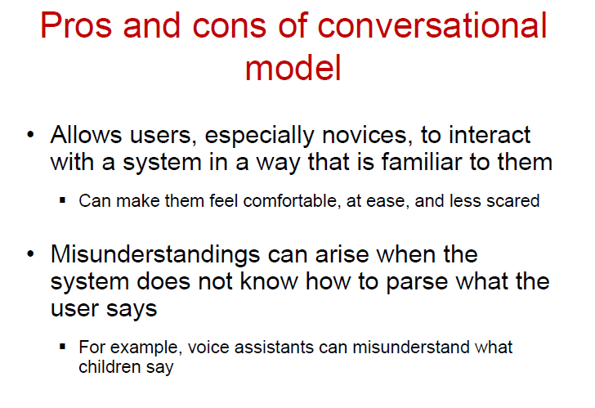

Slide 71
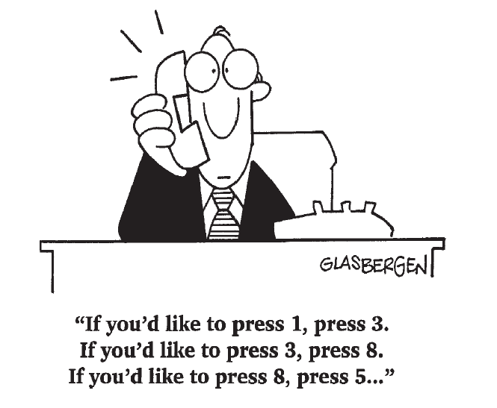

Slide 72
Cont…
3. Manipulating
User interacts by directly manipulating objects on the screen.
Best For: Intuitive, visual interfaces Challenge: May lack precision for some tasks
Feature | Example
Drag-and-drop | Rearranging files on desktop
Touch gestures | Zooming, swiping on phone
Slider controls | Adjusting volume or brightness

Slide 73
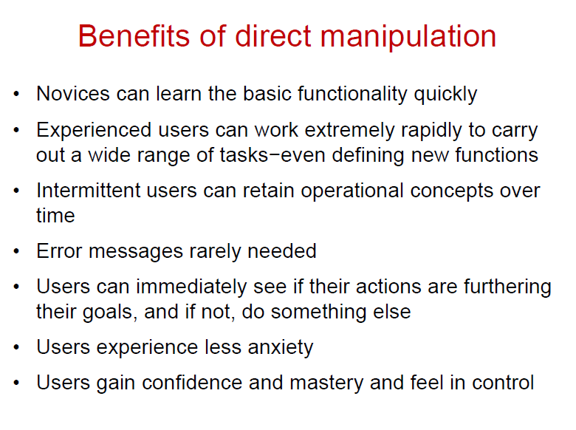
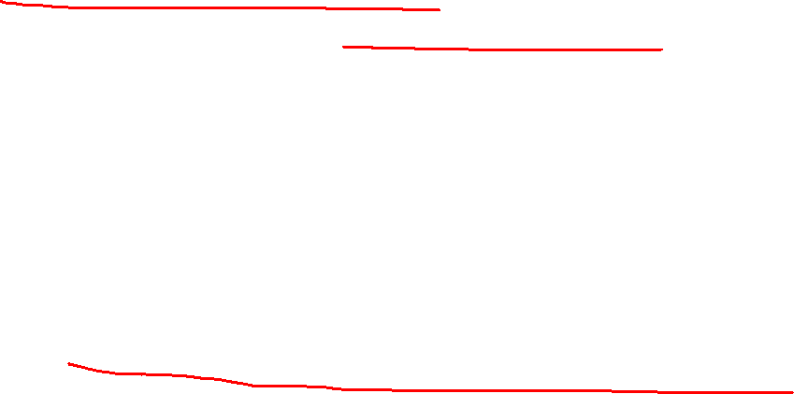

Slide 74
Cont…
4. Exploring / Navigating
User moves through a digital space to find content or perform tasks.
Best For: Discovery, spatial interfaces Challenge: Users can get lost; requires good information architecture
Feature | Example
Browsing menus | Website navigation
Zooming into maps | Google Maps
Exploring 3D spaces | VR environments, games

Slide 75
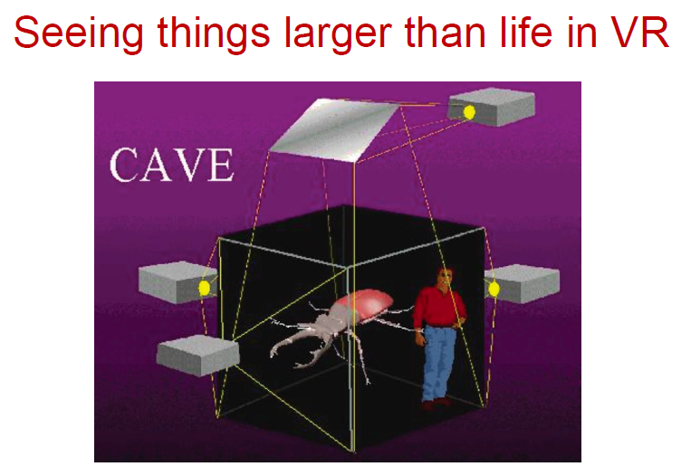
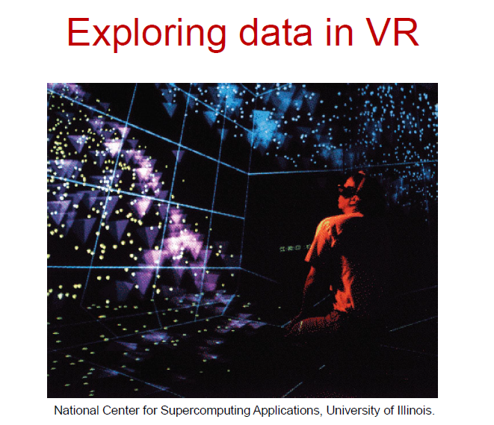

Slide 76
Cont…
5. Responding
System initiates interaction, and the user responds.
Best For: Controlled, guided experiences
Challenge: Overuse can lead to alert fatigue
Feature | Example
System prompts questions | Setup wizard
Notification requiring action | “Allow location access?”
Alerts & confirmations | “Are you sure you want to delete?”

Slide 77
Cont…
Choosing the Right Interaction Type:
Scenario | Recommended Type
Quick file management | Instructing or Manipulating
Smart assistant or help bot | Conversing
Data visualization or design apps | Manipulating
Website or app | Exploring/Navigating
System feedback | Responding

Slide 78
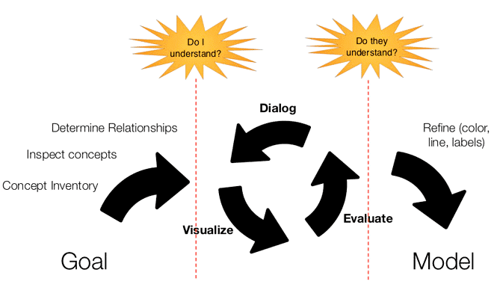
Conceptual Models in Human-Computer Interaction (HCI)

Slide 79

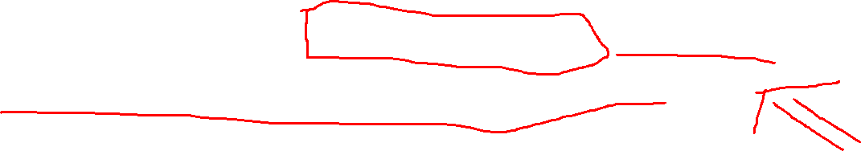
Cont…
1. What is a Conceptual Model?
A conceptual model is a mental representation of how a system works. It helps designers define the structure and behavior of an interactive system, and it helps users form expectations and understand how to interact with the system effectively.
Definition: A conceptual model is a high-level description of how a system is organized and operates, from the user's perspective.

Slide 80

Cont…
2. Purpose of a Conceptual Model
To communicate the underlying system functionality in a user-friendly way.
To guide the design of user interfaces.
To help users predict the effects of their actions on the system.
To reduce the learning curve by leveraging users’ prior knowledge or metaphors.

Slide 81
Feature | Conceptualizing Interaction | Conceptual Models
Definition | The overall process of understanding and defining how users interact with a system. | A specific representation or framework that describes how a system works from the user’s perspective.
Scope | Broader and includes different ways users interact (e.g., instructing, manipulating, conversing, exploring). | Narrower and more structured; includes metaphors, objects, actions, relationships, etc.
Purpose | Helps designers think about possible user behaviors and interaction types early in the design process. | Helps both designers and users understand, predict, and effectively use the system.

Slide 82

Feature | Conceptualizing Interaction | Conceptual Models
Includes | User goals, tasks, interaction types, flow of interaction, context. | Interface metaphors, objects, actions, system behavior assumptions.
When Used | In the initial ideation and user research phases of design. | In the modeling and design refinement stages.
Example Focus | "How should the user interact with this feature?" | "What real-world analogy (like desktop, folder) helps users understand the feature?"
Example | Deciding whether to design a chatbot (conversing) or a button-based UI (manipulating). | Using a "desktop metaphor" where files, folders, and trash bins mimic real-world behavior.

Slide 83
Cont…
3. Key Components of a Conceptual Model
Component | Description
Metaphors and Analogies | Real-world references that users can relate to (e.g., desktop metaphor).
Objects | The entities the user interacts with (e.g., files, icons, emails).
Actions/Operations | What users can do with those objects (e.g., open, save, delete).
Relationships | How different objects and actions are connected.
Assumptions | Rules or constraints that define system behavior (e.g., double-click opens a file).

Slide 84
Cont…
4. Types of Conceptual Models:
a. Interface Metaphors
Using familiar ideas from the physical world to represent digital interactions.
📁 Examples: “Desktop,” “Folder,” “Trash bin.”
b. Interaction Models
Purpose: Describe how users interact with the system.
Common Forms:
Direct manipulation (drag & drop)
Menu-based interaction
Command-line interaction

Slide 85
Cont…
3. Object-Action Interface Model
Purpose: Users select objects and perform actions on them.
Example:
In MS Word: object = text, action = bold/copy/delete
4. Mental Models
Purpose: Understand how users think the system works.
Importance: Helps align system design with user expectations.
Example:
Clicking “save” means the file is stored and safe.

Slide 86
Cont…
5. Benefits of Using Conceptual Models
Benefit | Description
Improves Usability | Users understand the system quickly.
Enhances Learnability | Familiar metaphors make learning easier.
Reduces Errors | Clear mental models prevent incorrect actions.
Promotes Consistency | Designers have a blueprint to follow.
Facilitates Communication | Helps teams share the same understanding.

Slide 87

Cont…
6. Example: Desktop Metaphor
Element in Model | Real-World Analogy
Files | Paper documents
Folders | File cabinets
Trash Bin | Wastebasket
Drag-and-drop | Moving papers on a desk
Users already know how to organize and use papers, so using the “desktop” metaphor makes digital interactions intuitive.

Slide 88
Cont…
7. Good vs. Poor Conceptual Models:
Good Model | Poor Model
Matches user’s mental model | Confuses or misleads users
Uses familiar terms & actions | Uses jargon or hidden logic
Clear relationships between elements | Disconnected or inconsistent elements
Provides feedback and support | Leaves users guessing

Slide 89
Cont…
8. Role in Design Process
Early-stage design: Helps define what the system is and how users interact with it.
Prototyping: Designers test and iterate based on how users understand the model.
Evaluation: Observing if users’ mental models align with the conceptual model.

Slide 90
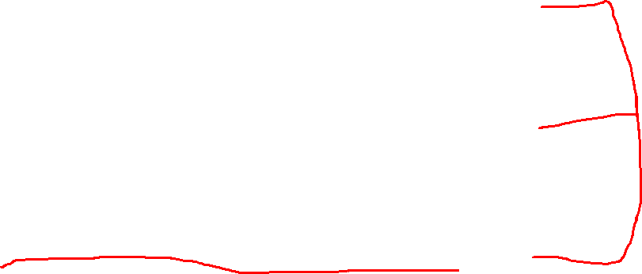
Cont…
9. User’s Mental Model vs Designer’s Model
User’s Mental Model: Internal understanding of how the system works.
Designer’s Conceptual Model: How the system is intended to work.
System Image: What the system actually shows to the user (UI, behavior, messages).
Goal in HCI: Align these three models as closely as possible.

Slide 91
Interface Metaphors in HCI (Human-Computer Interaction)

Slide 92
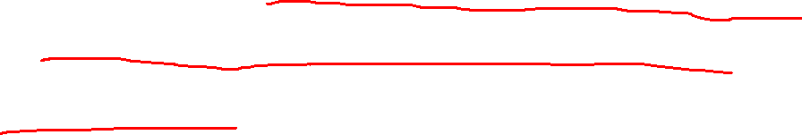
1. What is an Interface Metaphor?
An interface metaphor is a design approach that uses familiar real-world concepts to help users understand and interact with a digital system.
Definition: A metaphor in HCI maps familiar objects or actions from the physical world to functions and interactions in the digital interface.

Slide 93
2. Purpose of Interface Metaphors
To make systems intuitive and easy to learn
To bridge the gap between user expectations and system functionality
To reduce cognitive load by leveraging existing knowledge
To enhance usability and learnability

Slide 94
Cont…
Interface metaphors are a cornerstone of user-friendly system design.
When applied wisely, they enhance usability, boost user confidence, and make technology accessible even to non-technical users.
However, designers must balance realism with functionality to avoid confusing or limiting user interaction.

Slide 95
3. Common Examples of Interface Metaphors
Interface Element | Real-World Metaphor | Description
🖥️ Desktop | Office Desk | Organizing files and folders like paperwork
🗂️ Folder | Physical File Folder | Grouping files/documents together
🗑️ Trash Bin | Wastebasket | Delete or discard items
📂 File Icon | Paper Document | Represents a document
📤 Outbox | Postal Outbox | Sending emails or messages
🛒 Shopping Cart | Grocery Cart | Collecting items before purchase in e-commerce
🧭 Browser Tabs | File Dividers | Multiple open documents in a filing system
🎛️ Control Panel | Switchboard/Dashboard | Settings and configurations

Slide 96

Cont…
Desktop Metaphor (Used in Windows/macOS):
Represents the screen as a physical desk with files, folders, trash bins, and documents.
Users drag and drop, open folders, and delete items—just like real-world behavior.
Impact on Usability:
Ideal for beginners; promotes mental continuity from the physical world to the digital world.
However, it becomes less useful for complex tasks like cloud syncing, which don't exist in real-life desks.

Slide 97
Cont…
B. Shopping Cart Metaphor (Used in Amazon, Flipkart)
Mimics a real-world shopping cart where users add and remove products before checkout.
Visual cues like "Add to Cart" or "Proceed to Checkout" mirror in-store shopping.
Impact on Usability:
Easy for users to understand the flow of browsing → collecting → purchasing.
Reinforces task completion and gives a clear mental model of the process.

Slide 98

4. Types of Interface Metaphors
Direct Metaphors
Exact replication of physical-world behavior
Example: Dragging a file to the trash deletes it
Abstract Metaphors
Loosely inspired by the real world but simplified or adapted
Example: Tabs in a web browser – inspired by file folders

Slide 99
5. Advantages of Interface Metaphors
Benefit | Explanation
💡 Learnability | Easy for new users to understand and start using the system
⚙️ Intuitiveness | Reduces need for instructions or training
📚 Transfer of Knowledge | Users rely on previous real-world experience
🧭 Navigation | Users can predict system behavior and flow
🧠 Memory Aid | Real-world imagery makes features memorable

Slide 100
6. Disadvantages or Limitations
Limitation | Description
❌ Over-simplification | May not fully represent complex digital actions
🔄 Mismatch with digital reality | Real-world rules don’t always apply (e.g., unlimited undo, infinite storage)
🧱 Constraint on innovation | Metaphor may limit creative interface design
📉 Cultural bias | Some metaphors may not be universal

Slide 101
7. Best Practices for Designing Interface Metaphors
Use familiar metaphors aligned with the target user's environment
Ensure consistency with real-world logic and behavior
Avoid overextending the metaphor where it breaks down
Consider cultural differences (e.g., calendar styles, currency)
Allow flexibility and abstraction when needed

Slide 102
8. Metaphors in Mobile Interfaces
Mobile Interface | Metaphor Used
Swipe to Unlock | Sliding a bolt or curtain
Pinch to Zoom | Stretching a surface
Voice Assistant Icon | Microphone or speaker
Notification Bell | Desk bell or alarm system

Slide 103
Conclusion:
While metaphors help users by building on familiar concepts, they also introduce limitations:
Some metaphors become outdated or fail to evolve with new technology (e.g., floppy disk icon for "Save").
Over-reliance can restrict innovation if designers avoid breaking metaphor boundaries even when needed.
However, when thoughtfully applied, metaphors significantly enhance intuitive interaction and reduce the learning curve—making them vital to user-centered design.

Slide 104
Paradigms, Visions, Challenges, Theories, Models, and Frameworks

Slide 105
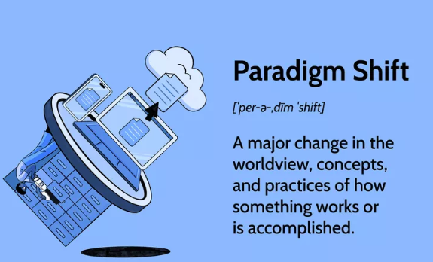

Cont…
Paradigms in HCI:
Paradigms are broad models or worldviews that guide the development and evaluation of interactive systems.
A paradigm is a dominant approach or mindset that shapes how technology is designed and used. It reflects a shift in how humans interact with computers.

Slide 106
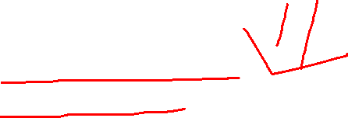
Cont…
Paradigm | Focus | Example
Human-Machine Interaction | User as an operator of a system | Command line interfaces
Human-Centered Design (HCD) | User needs, usability, and context | User testing and persona-driven design
Ubiquitous Computing | Computing embedded everywhere | Smart homes, wearable devices
Tangible Interaction | Physical manipulation of digital info | Interactive tabletops
Context-Aware Systems | Systems respond to real-world context | Google Maps adjusting based on location

Slide 107

Cont…
2. Visions of HCI:
Visions represent future directions or aspirations in HCI development.
Examples:
The Metaverse: A shared, immersive 3D digital world.
Brain-Computer Interfaces: Controlling computers with thought.
Purpose: Inspire innovation and push the boundaries of interaction design.

Slide 108

Cont…
Vision | Description
Calm Technology | Technology that stays in the background until needed (Weiser’s vision)
Natural User Interfaces (NUI) | Gesture, speech, touch-based interactions
Post-WIMP Interfaces | Moving beyond windows, icons, menus, pointer
Brain-Computer Interfaces (BCI) | Direct communication between brain and machine
AI-Augmented Interaction | Interfaces that adapt and learn from user behavior

Slide 109
Cont…
3. Challenges in HCI
These are problems and limitations designers and researchers face when creating human-centered technology.
Challenge | Description
Balancing usability and functionality | Too many features may overwhelm users
Accessibility and inclusivity | Designing for people with disabilities
Privacy and security | Especially in pervasive and AI-driven systems
Cultural diversity | Interface design must respect cultural differences
Sustainability | Eco-conscious interface and device design
Rapid tech change | Adapting to new interaction modalities (e.g., AR, VR)

Slide 110

Cont…
4. Theories in HCI:
Purpose: To explain how and why users interact with systems the way they do. Theories provide systematic explanations of how people interact with technology. They help designers understand user behavior.
Theory | Focus
Distributed Cognition | Thinking is shared between people and tools
Activity Theory | Interaction shaped by social and cultural context
Situated Action Theory | Actions emerge in response to real-time context
Information Processing Theory | Users are like processors of information
Fitts’s Law | Predicts time to move to a target (important in UI design)

Slide 111
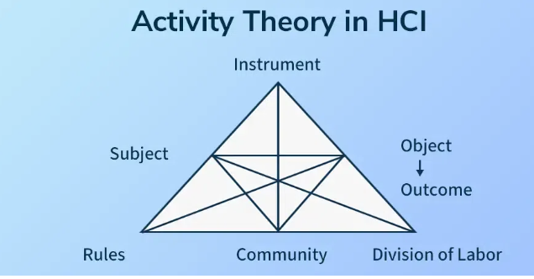

Slide 112

Cont…
5. Models in HCI
Models help simplify and represent user-system interaction.
Model | Description
Norman’s Seven Stages of Action | Describes user goals, execution, and evaluation
Model Human Processor (MHP) | Simulates human cognitive processes like perception, motor, memory
GOMS (Goals, Operators, Methods, Selection Rules) | Predicts task execution time
Fitts’s Law | Predicts the time to point at a target
Hick’s Law | Decision time increases with number of choices

Slide 113
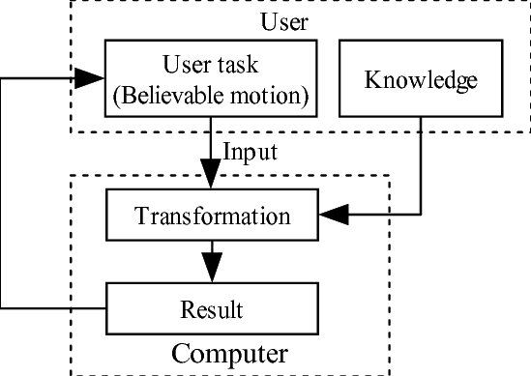
HCI model for physical simulation

Slide 114
Cont…
6. Frameworks in HCI
Frameworks are structured approaches for design, evaluation, and understanding.
Framework | Use
User-Centered Design (UCD) | Iterative design based on user feedback
Four Pillars of Design | User, task, context, usability
Interaction Framework (Abowd & Beale) | Maps input/output transformations
ISO 9241-210 | International usability standards
Dix’s Interaction Framework | Breaks down user, input, system, and output processes

Slide 115
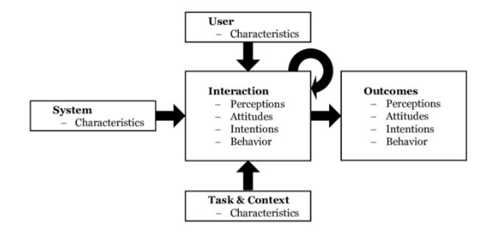

Slide 116
Cont…
Concept | Purpose | Example
Paradigm | Mindset or trend | GUI, Conversational AI
Vision | Aspirational future idea | Ubiquitous computing
Challenge | Design/tech difficulty | Accessibility
Theory | Explains human behavior | Activity Theory
Model | Describes interaction process | Norman’s Model
Framework | Guide for design/evaluation | UX Honeycomb

Slide 117
Case Studies Based on Module 2:
S.No | Case Study Title | Focus Area | Key Learning Objectives
1️⃣ | Redesigning a University Student Portal | User-Centered Design (UCD) | Understand user needs through personas, apply iterative design, test prototypes
2️⃣ | Mobile Banking App for Elderly Users | Accessibility & Practical Design Issues | Address physical/cognitive limitations, ensure clear interaction flow
3️⃣ | E-Commerce Website Wireframing | Wireframing & Low-Fidelity Prototyping | Design layout and user flow using early mockups before actual development

